Slide 1



Welcome
To our software development project about
Computer Shop and Management System

Slide 2

Team Binary
Course Title: Software Development-1 Course Code : CSE 100
This course was Supervised By:
Partho Ghosh Lecturer Bangladesh University of Business and Technology Dept. of CSE
1. Name: Niamul Hassan Samin
ID : 21224103004
2. Name: Renu Akter Sweety
ID : 21224103045
3. Name: Anika Ibnat Ema
ID : 21224103187
4. Name: Shahriar Alom Fahim
ID : 21224103036

Slide 3

Overview
Introduction
01
Features
02
Flowchart
03
Demo
04
Limitation
05
Future Work
06
Conclusion
07

Slide 4
Introduction
The Motivation : Technology and Shopping are two of the most essential part of our daily life .
Accessibility : We can buy product by selecting products from the list and get final bill .
The purpose : we to provide easy shopping facility from every corners around the world and technology for ever

Slide 5

Key features
Easy To buy Products
Proper product display
Saving time
Total cost calculator

Slide 6

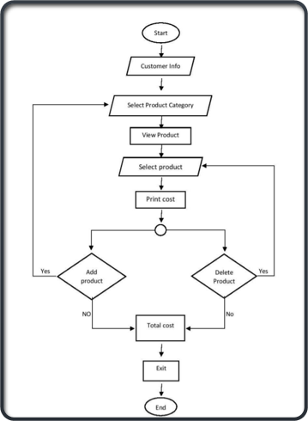
Flowchart

Slide 7
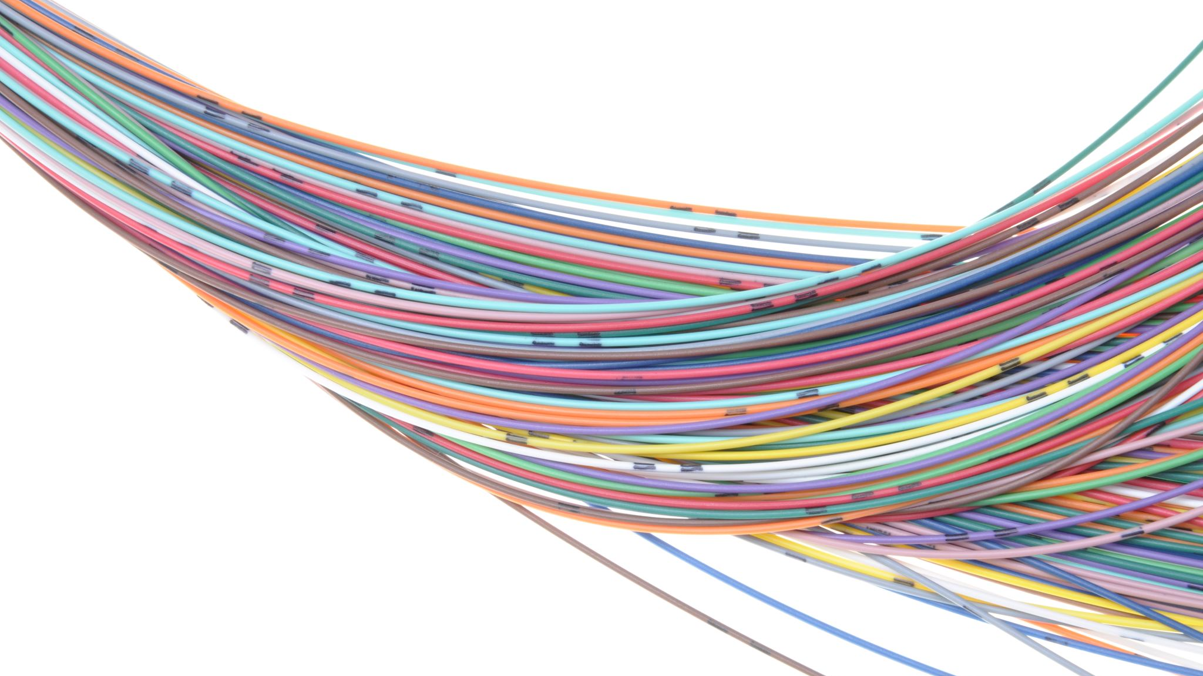
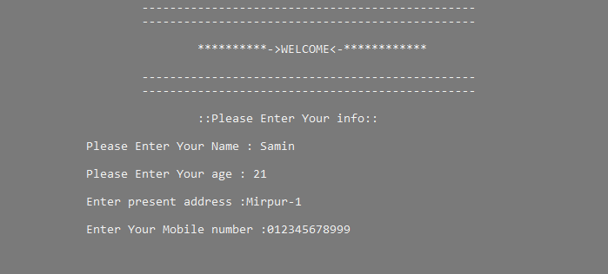
Demo
This is the welcome page of our project

Slide 8

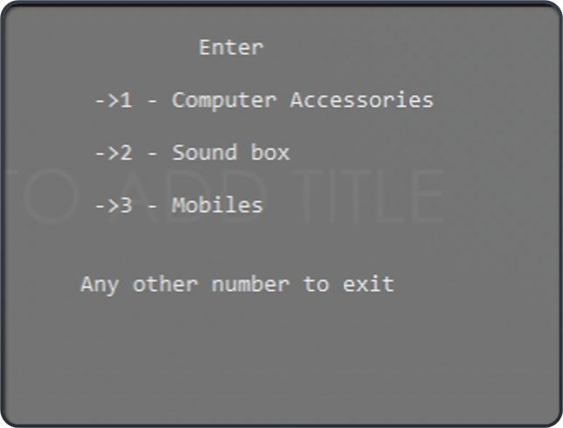
Product category

Slide 9

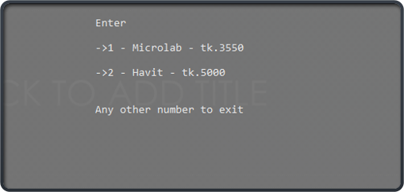
Select Product

Slide 10

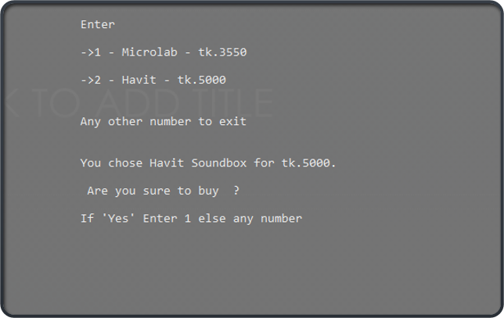
•Confirmation before buying :

Slide 11

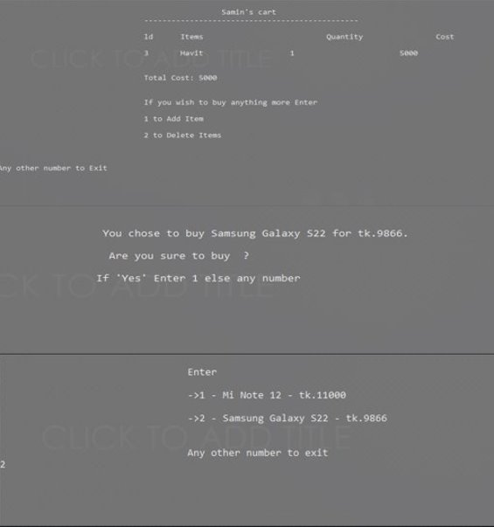
Add a Product :

Slide 12

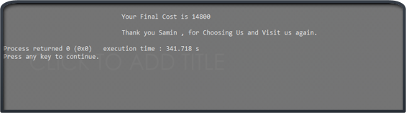
Printing the bill with Total cost calculator :

Slide 13

Limitations
Many necessary features are not available .
Can’t print the final bill with product details .

Slide 14

Future Works
• Want to increase facilities of this project.
• Want to add printing option.
• Want to develop graphical design.

Slide 15

CONCLUSION
This is a small and without security program. Anyone can manipulate the stored result. This program had some garbed code and easy logic. Anyone can be use this program on super shop to billing system and store customers information. This program is not a final version, It may develop mobile and web version.

Slide 16


Thank you

